Slide 1



Department of Cyber Security
2026–2027 – Odd Semester
III Year / V Semester
CS23533 – FOUNDATIONS OF ARTIFICIAL INTELLIGENCE
Cyber Intelligence System
Project Review – 1
Rajalakshmi Engineering College
Department of Cyber Security

Slide 2
Introduction
2
• SHERLOCK is an explainable, rule-based cybersecurity intelligence system.
• It analyzes a user’s description of a cybersecurity situation.
• A Knowledge Base and Inference Engine identify known threat patterns.
• It provides threat, category, severity, explanation, evidence and recommended action.
• It is a Classical AI expert-system application for cybersecurity decision support.
Department of Cyber Security | Project Review – 1 | 2026–2027

Slide 3
Problem Statement
3
• Cybersecurity incidents can be difficult for ordinary users to understand.
• Users may notice failed logins, suspicious emails, unknown software or unusual network activity.
• A generic “Threat Detected” alert does not explain why the decision was made.
• Users need a simple way to connect observable behaviour with known cybersecurity threats.
• The system should provide reasoning and recommended action rather than only a threat label.
Department of Cyber Security | Project Review – 1 | 2026–2027

Slide 4
Motivation
4
• Make cybersecurity situations easier for non-expert users to interpret.
• Apply FOAI Classical AI concepts to a practical cybersecurity problem.
• Use explicit knowledge, facts and IF–THEN rules for transparent reasoning.
• Explain what matched, why it matched and what action should be considered.
• Support security awareness through severity, recommendations and applicable MITRE ATT&CK references.
Department of Cyber Security | Project Review – 1 | 2026–2027

Slide 5
Objectives
5
• To represent cybersecurity knowledge using facts and IF–THEN rules.
• To develop an inference engine for rule-based logical threat analysis.
• To demonstrate Forward Chaining and the concept of Backward Chaining.
• To classify situations into known threats or a Suspicious / Potential Threat category.
• To generate explainable results with severity, evidence, recommendations and applicable MITRE mapping.
Department of Cyber Security | Project Review – 1 | 2026–2027

Slide 6
Literature Survey
6
S.No. | Author & Year | Method / Technique | Key Findings | Limitations
1 | Buchanan & Shortliffe, 1984 | Rule-based expert system | MYCIN demonstrated explicit knowledge representation and inference rules for expert decision support. | Knowledge is limited to the encoded domain rules.
2 | Giarratano & Riley, 2005 | Expert systems; knowledge representation; inference | Expert systems combine a knowledge base with an inference engine to derive decisions. | Performance depends on knowledge quality and coverage.
3 | MITRE ATT&CK | Adversary tactics and techniques knowledge base | Provides structured cybersecurity techniques that can support threat classification and mapping. | Mappings must be selected carefully for the observed behaviour.
Department of Cyber Security | Project Review – 1 | 2026–2027

Slide 7
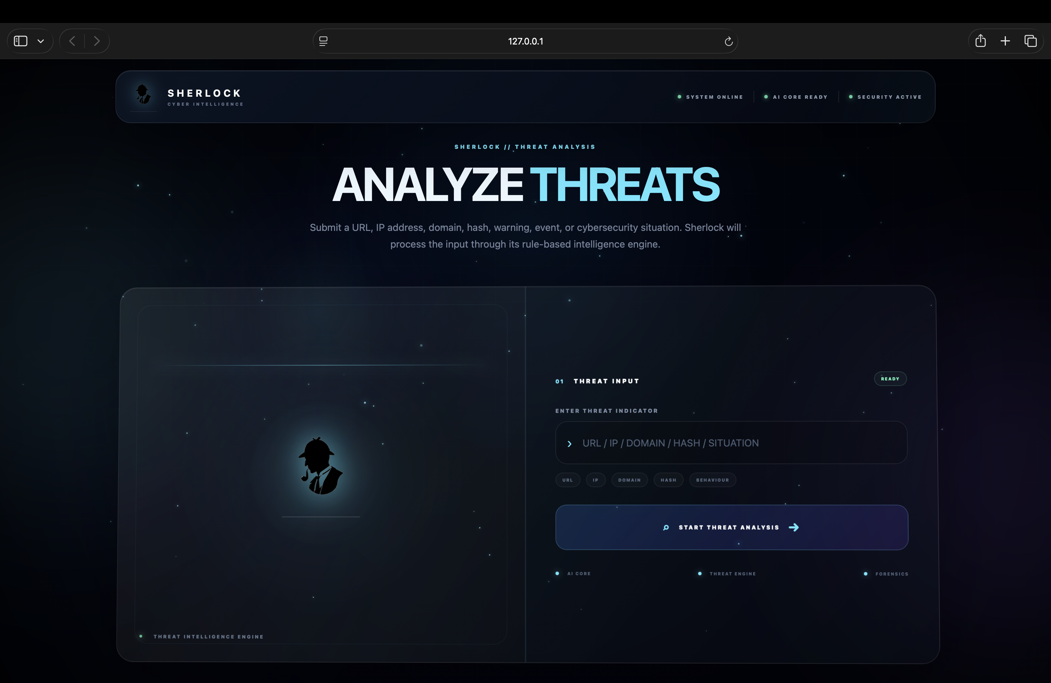
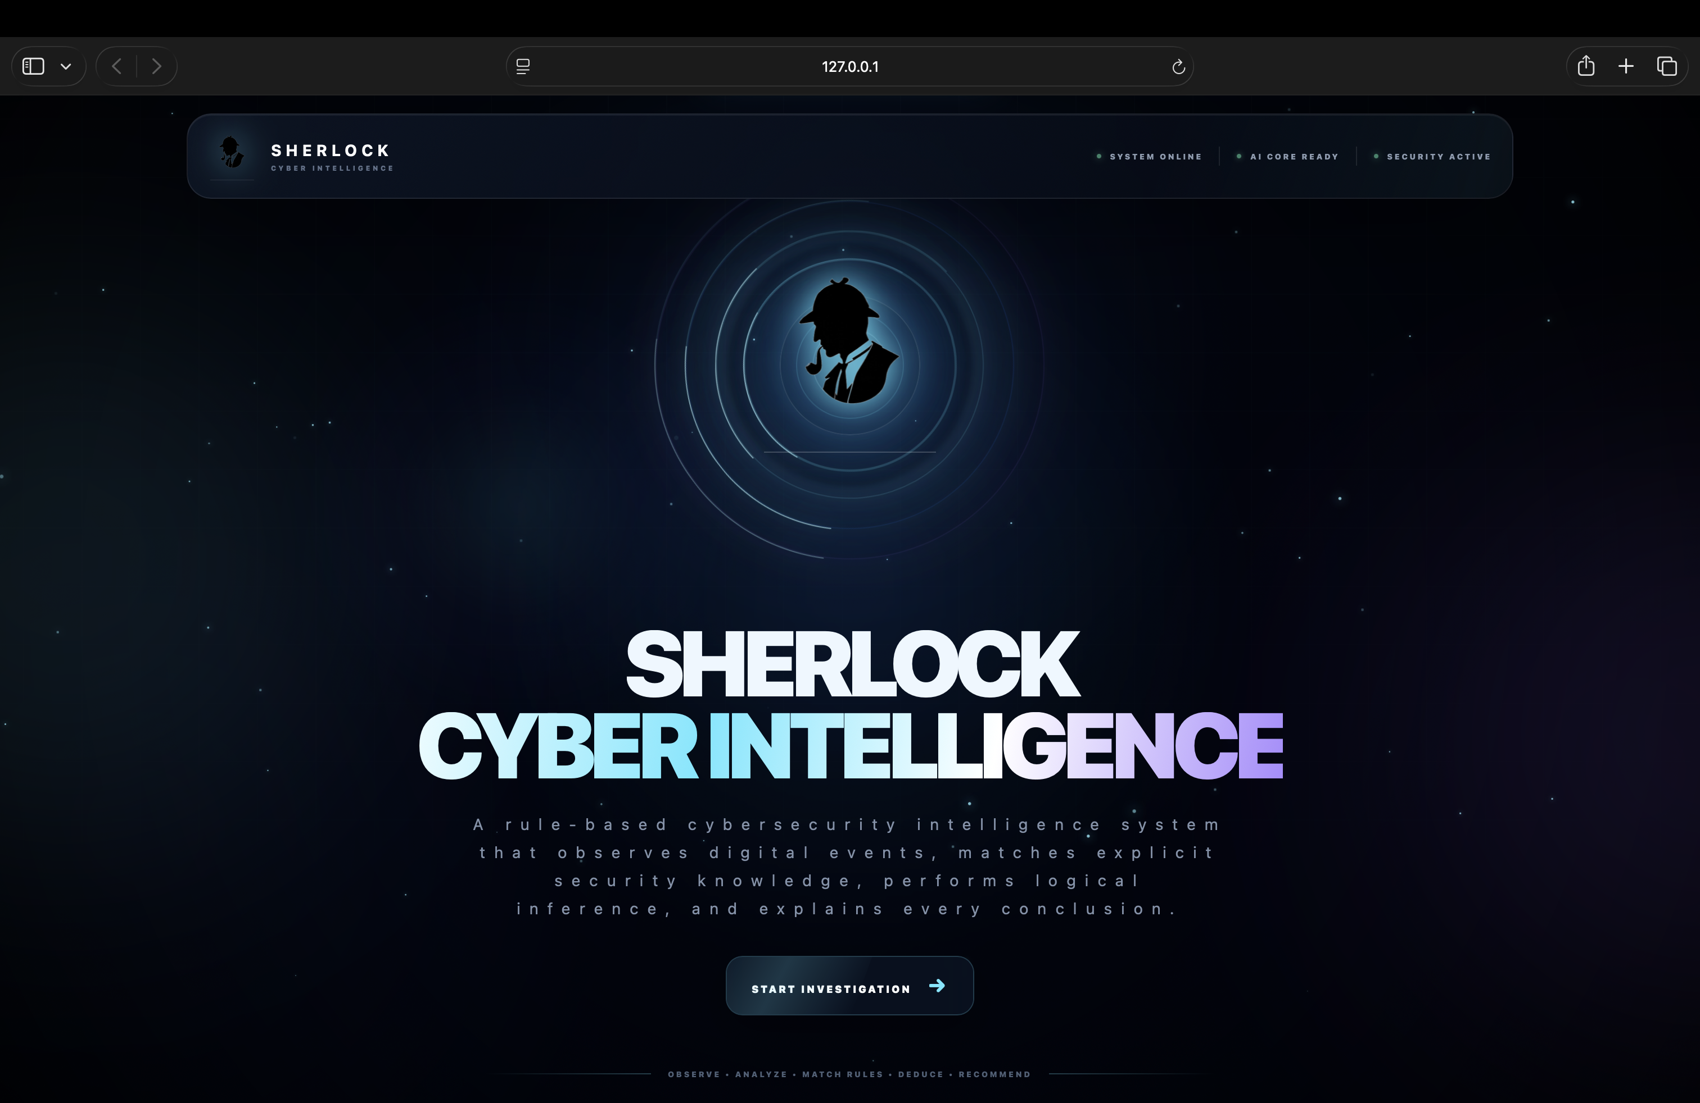
Existing System
7
Existing approach
• Manual interpretation, static security guidance and generic alerts.
• Users often need cybersecurity knowledge to interpret the event.
Advantages
• Security information and known attack patterns are available.
Limitations
• Generic alerts may not explain matched evidence or next action.
• Fixed labels may not adequately describe ambiguous situations.
USER
OBSERVATION
MANUAL / GENERIC
INTERPRETATION
ACTION BASED ON
AVAILABLE GUIDANCE
Department of Cyber Security | Project Review – 1 | 2026–2027

Slide 8
Proposed System
8
• SHERLOCK accepts a user-described cybersecurity situation.
• It identifies relevant facts and matches them with a cybersecurity Knowledge Base.
• The Inference Engine applies explicit IF–THEN rules using logical reasoning.
• The result includes threat, category, severity, explanation, evidence, recommendation and applicable MITRE mapping.
• If no specific rule is supported, the system uses “Suspicious / Potential Threat” rather than pretending to know the exact attack.
USER INPUT
KNOWLEDGE BASE
INFERENCE ENGINE
THREAT ANALYSIS
EXPLANATION &
RECOMMENDATION
Department of Cyber Security | Project Review – 1 | 2026–2027

Slide 9
System Architecture / Block Diagram
9
USER INPUT
SECURITY SITUATION
KNOWLEDGE
REPRESENTATION
RULE
MATCHING
INFERENCE
ENGINE
THREAT
ANALYSIS
EXPLANATION &
RECOMMENDATION
SHERLOCK
RESULT
Core pipeline: USER INPUT → KNOWLEDGE BASE → INFERENCE ENGINE → THREAT ANALYSIS → EXPLANATION & RECOMMENDATION
Department of Cyber Security | Project Review – 1 | 2026–2027

Slide 10
Methodology
10
1. USER INPUT
Enter the cybersecurity situation.
2. FACT IDENTIFICATION
Identify relevant observable facts.
3. KNOWLEDGE BASE
Retrieve matching cybersecurity rules.
4. INFERENCE
Apply Forward / Backward reasoning.
5. THREAT ANALYSIS
Determine threat, category and severity.
6. EXPLANATION
Show evidence, action and applicable mapping.
Department of Cyber Security | Project Review – 1 | 2026–2027

Slide 11
Technologies Used
11
Programming Language: Python
Framework: Flask
Frontend: HTML, CSS, JavaScript
Data Format: JSON
Development Environment: Visual Studio Code
AI Logic: Rule-based Classical AI
Reasoning: Forward Chaining + Backward Chaining concept
Hardware: No special hardware required
Department of Cyber Security | Project Review – 1 | 2026–2027

Slide 12
Module Description
12
Module 1 – User Input
Accepts the user’s cybersecurity situation.
Module 2 – Knowledge Base
Stores facts and IF–THEN cybersecurity rules.
Module 3 – Inference Engine
Performs rule-based logical reasoning.
Module 4 – Threat Analysis
Identifies possible threat, category and severity.
Module 5 – Explanation & Recommendation
Explains the reasoning and recommends an appropriate action.
Department of Cyber Security | Project Review – 1 | 2026–2027

Slide 13
Preliminary / Expected Results
13
USER INPUT
“My account has received hundreds of failed login attempts in a short period.”
SHERLOCK ANALYSIS
Threat: Brute Force Attack
Category: Credential Access
Severity: HIGH
WHY?
Repeated failed authentication attempts matched the relevant rule.
RECOMMENDATION
Review logs • Block suspicious sources • Enable MFA • Reset credentials if necessary
MITRE ATT&CK: T1110 | Related threats: Password Spraying, Credential Stuffing
Expected outcome: explainable threat analysis without claiming guaranteed detection of unknown attacks.
Department of Cyber Security | Project Review – 1 | 2026–2027

Slide 14
Project Schedule
14
Activity | Month 1 | Month 2 | Month 3 | Month 4
Literature Survey | ✓ | ✓
Problem Identification | ✓ | ✓
System Design | ✓ | ✓ | ✓
Implementation |  | ✓ | ✓ | ✓
Testing & Evaluation |  |  | ✓ | ✓
Department of Cyber Security | Project Review – 1 | 2026–2027

Slide 15
Current Progress
15
• ✓ Literature survey completed
• ✓ Problem identification completed
• ✓ Requirement analysis and Classical AI methodology finalized
• ✓ Knowledge base and threat categories specified
• ✓ Inference and explanation workflow designed
• ✓ Web-based working model implemented
• ☐ Systematic testing and evaluation
• ☐ Final documentation and presentation
Department of Cyber Security | Project Review – 1 | 2026–2027

Slide 16
Future Work
16
• Expand the cybersecurity knowledge base and rule coverage.
• Improve rule organization and conflict handling when multiple rules match.
• Add more detailed evidence trails for each inference step.
• Conduct systematic testing using representative cybersecurity scenarios.
• Improve the web interface and presentation of threat explanations.
• Extend MITRE ATT&CK references only where an applicable mapping is verified.
• Prepare final documentation and project demonstration.
Department of Cyber Security | Project Review – 1 | 2026–2027

Slide 17
Conclusion
17
• SHERLOCK demonstrates how Classical AI can be applied to cybersecurity intelligence.
• It uses knowledge representation, facts, IF–THEN rules, logical inference, Forward Chaining and Backward Chaining.
• Its main strength is transparent, rule-based explainability.
• It distinguishes known threats from suspicious or insufficiently supported situations.
• It provides a practical FOAI working model for cybersecurity decision support.
• It is not an antivirus, malware scanner or guaranteed zero-day detection system.
Department of Cyber Security | Project Review – 1 | 2026–2027

Slide 18
References
18
[1] B. G. Buchanan and E. H. Shortliffe, Rule-Based Expert Systems: The MYCIN Experiments, Addison-Wesley, 1984.
[2] J. Giarratano and G. Riley, Expert Systems: Principles and Programming, 4th ed., Course Technology, 2005.
[3] MITRE, MITRE ATT&CK Enterprise knowledge base and technique references.
[4] CS23533 – Foundations of Artificial Intelligence, Rajalakshmi Engineering College, course syllabus and concepts.
Department of Cyber Security | Project Review – 1 | 2026–2027

Slide 19
THANK YOU
Questions & Suggestions
Department of Cyber Security | Project Review – 1 | 2026–2027

